Slide 1
Snell’s Law

Slide 2

By the end of this Smart Lesson, you should be able to:
Calculate the critical angle when light passes between two different media.
Write Snell's law equation.
Explain what the critical angle is.

Slide 3
When light passes from a more dense substance into a less dense substance at a certain angle, something very interesting happens.
As the angle increases, light is eventually unable to pass from the more dense medium. Instead, it travels along the boundary of the two media.
The angle at which this occurs is known as the critical angle.

Slide 4
So how do we know where the critical angle is?
The critical angle varies depending on the density of the two media.
However, we can calculate the critical angle by using an equation known as Snell's law!

Slide 5

We can use Snell's Law to find the critical angle.
This is Snell's Law:
n_{i​}sinθ_{i}​=n_{r}​sinθ_{r}​

Slide 6
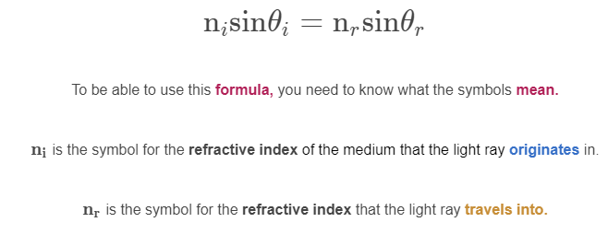
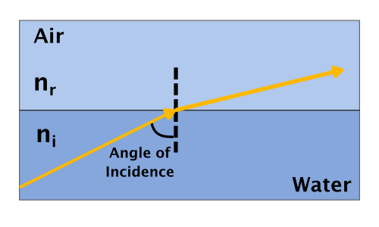

Slide 7
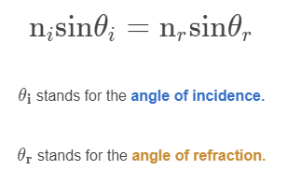
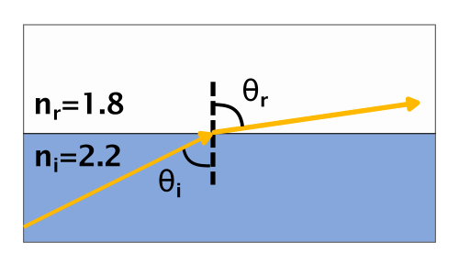

Slide 8

Now that we know the equation, let's work through an example together.
Calculate the critical angle when a light ray travels from a medium with a refractive index of 2.2 to a medium with a refractive index of 1.8.
Remember: the angle of refraction must always be 90∘ when the angle of incidence is the critical angle.

Slide 9
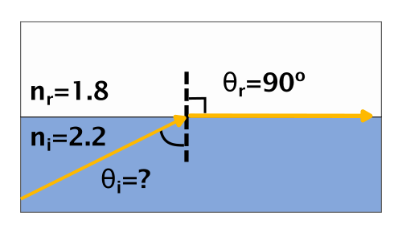
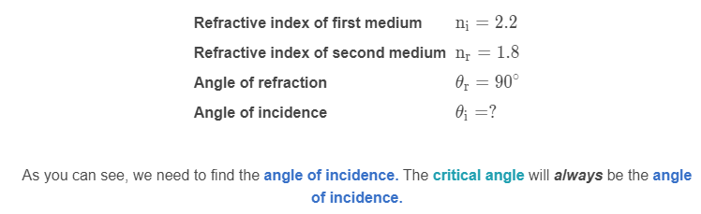
Example calculation
Calculate the critical angle when a light ray travels from a medium with a refractive index of 2.2 to a medium with a refractive index of 1.8.
First, we need to extract the information out of the question.

Slide 10
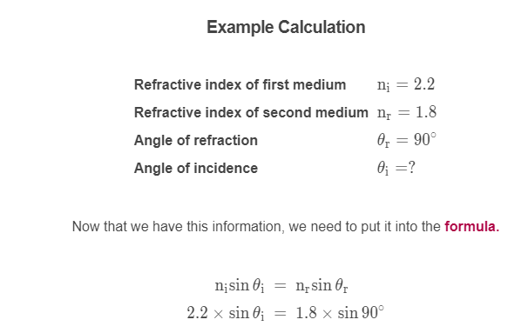

Slide 11
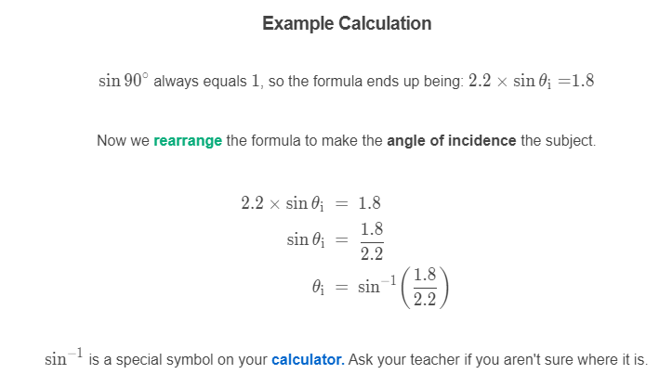

Slide 12
